Slide 1
Presentation Raytracer
Group members:
Rutger van den Berg 4060156
Ymte Jan Broekhuizen 4246586
Qu Chen 1256025
Arend Jan de Graaff 4012534
Max Groeneboom 4169298
Rick van Hattem 1297295
Ewoud van der Heide 1534033
Leon Hoek 4021606
Vince Kasanpawiro 4028880

Slide 2
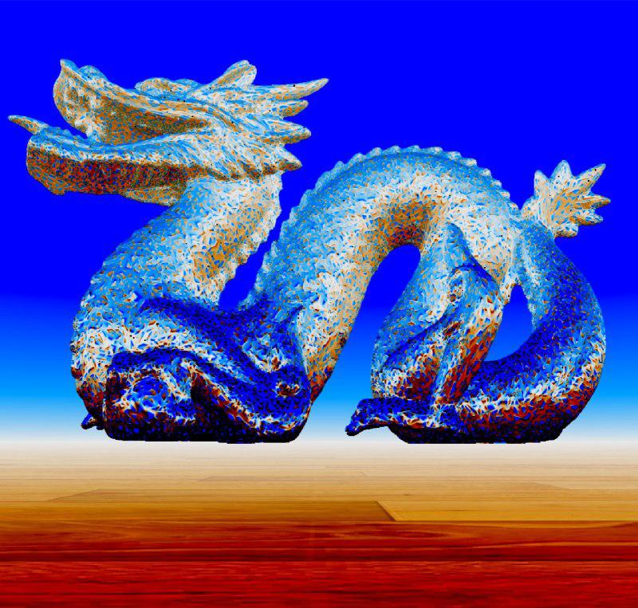
Competition Image
Our product

Slide 3
Work Distribution
Distribution by team member
Rutger: Debugging Linux, reflection, 3d models.
Ymte Jan: Octree, multithreading, RealTime RayTracing, shadows, motion, ground textures, Phong shaders.
Qu: Debugging Visual Studio, Ray-Intersection,
presentation.
Arend Jan: Windows operations, 3d models, presentation.
Max: Ray-Intersection, 3d models, shadows, FPS counter
Rick: Multithreading, 3d models, debugging McOS, hosted git, timer, rewriting, background raytracing, FPS counter, RealTime RayTracing
Ewoud: Colouring, 3d models, Debugging Linux
Leon: Octree, debugging Linux, 3d models
Vince: 3d models, presentation, debugging Visual Studio

Slide 4
Presentation
The actual topics
Start of Project
Raytracing
Normals
Duration
Extras
Demo

Slide 5
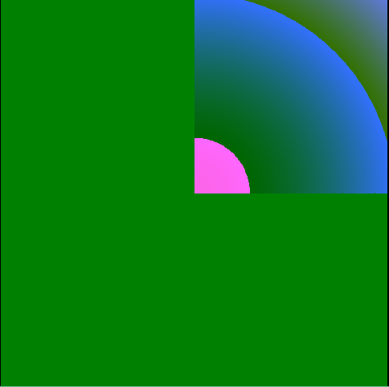
Psychedelic Art
Start of project

Slide 6
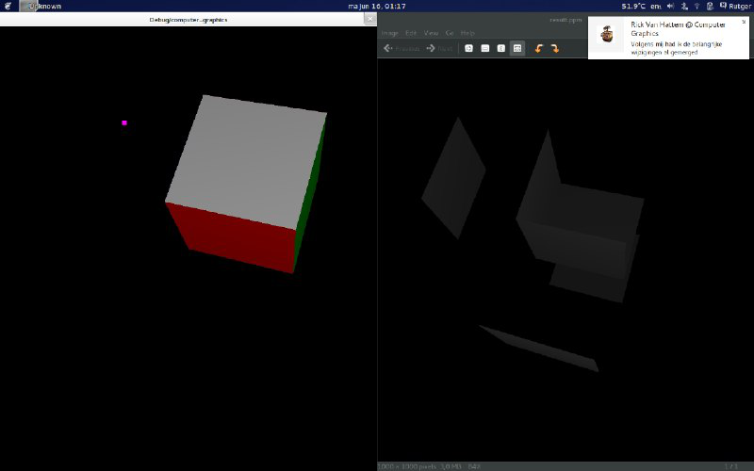
Cube Rendering
Start of project

Slide 7
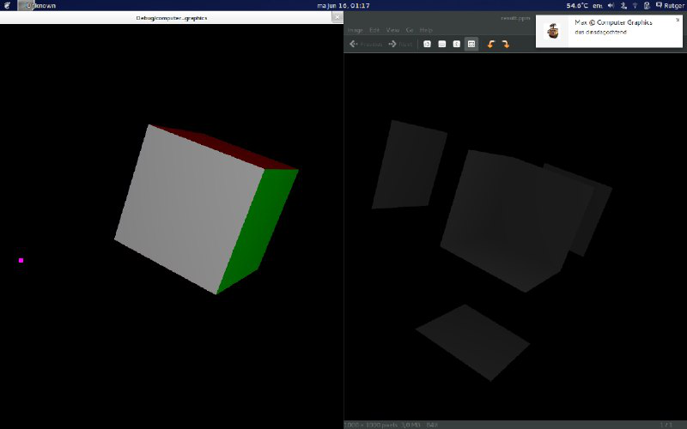
Cube Rendering
Start of project

Slide 8
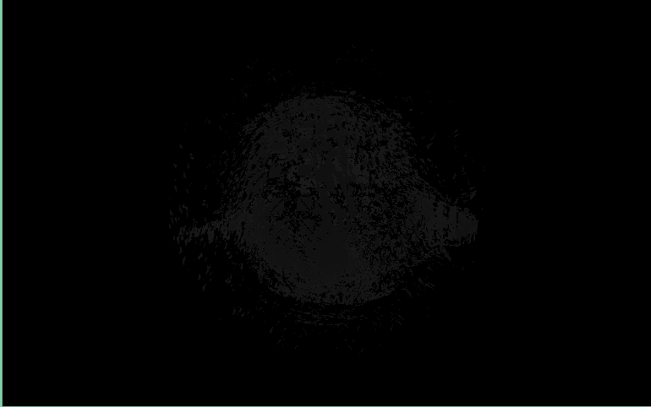
Monkey Rendering
Start of project

Slide 9
Presentation
The actual topics
Start of Project
Raytracing
Normals
Duration
Extras
Demo

Slide 10
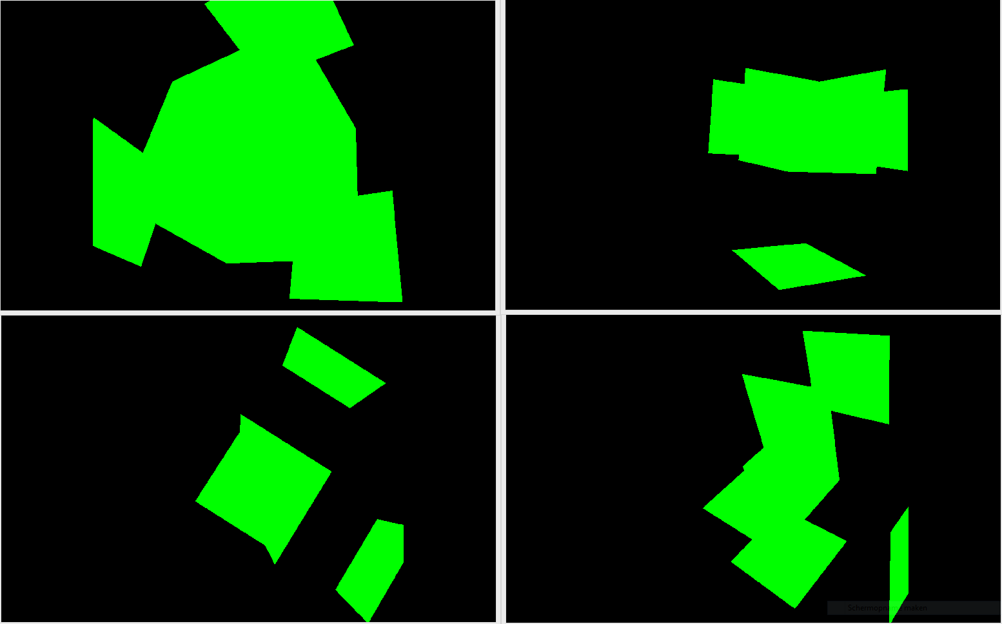
Geometric Ray Tracing
Raytracing

Slide 11
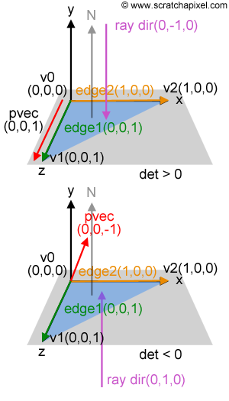
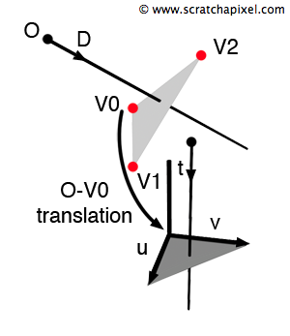
Solution
Raytracing - Möller Trumbore intersection method

Slide 12
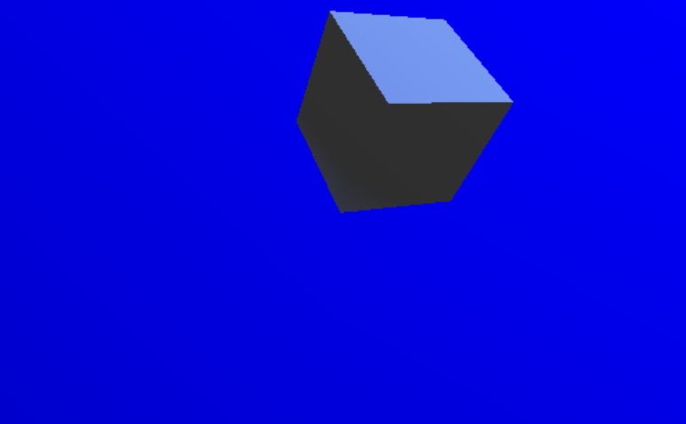
Result
Raytracing - intersection working

Slide 13
Presentation
The actual topics
Start of Project
Raytracing
Normals
Duration
Extras
Demo

Slide 14
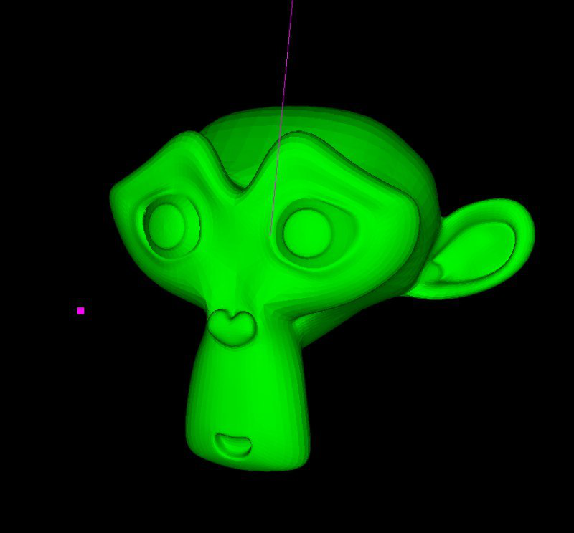
New Mesh
Normals - Blender’s monkey

Slide 15
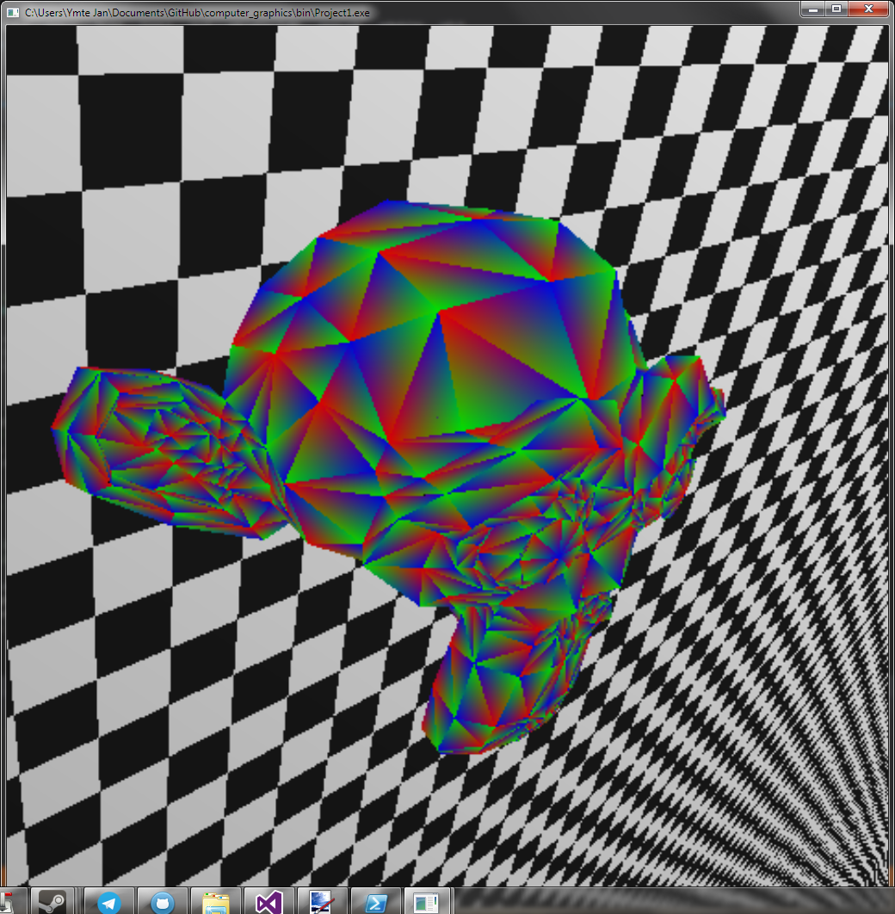
Blinn-Phong
Normals - used as colour

Slide 16
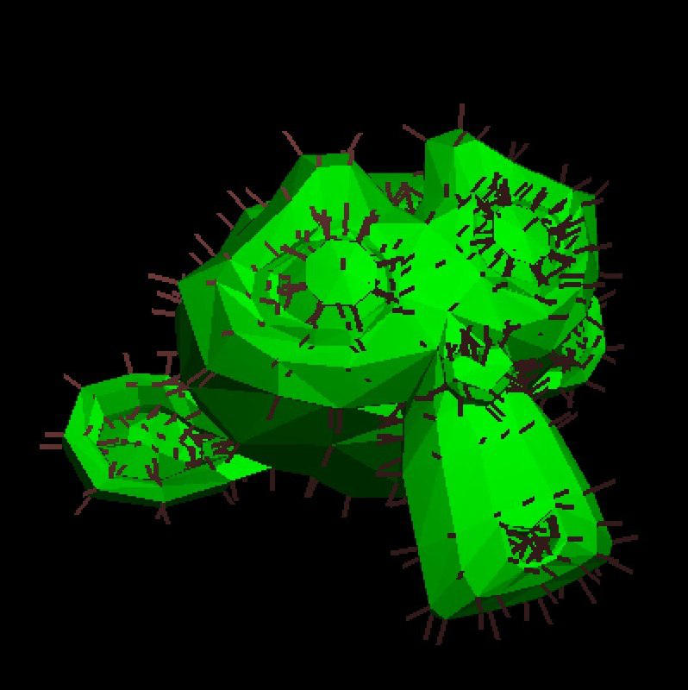
Actual normals
Normals – Using simpleMonkey

Slide 17
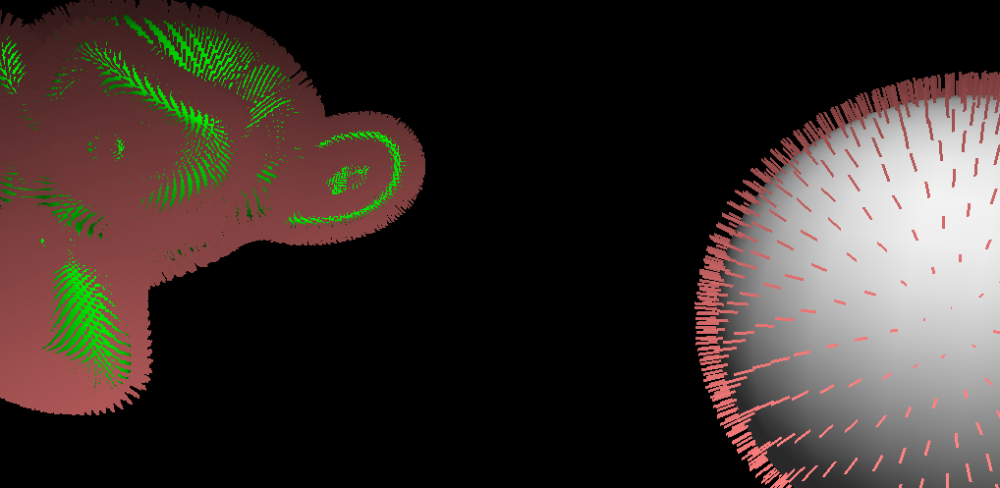
Actual normals
Normals – Applied to other models

Slide 18
Presentation
The actual topics
Start of Project
Raytracing
Normals
Duration
Extras
Demo

Slide 19
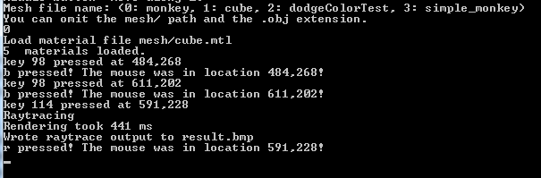
Challenges
Duration

Slide 20
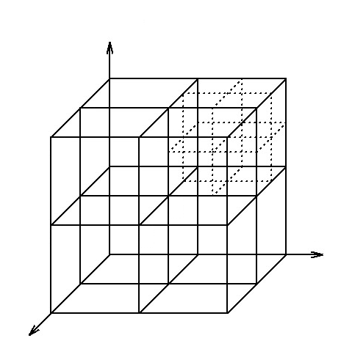
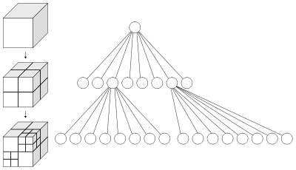
Octrees
Duration – possible solution

Slide 21
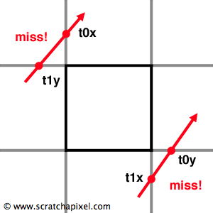
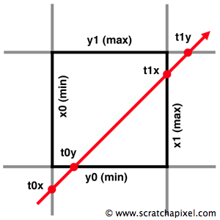
Octrees
Duration – possible solution

Slide 22
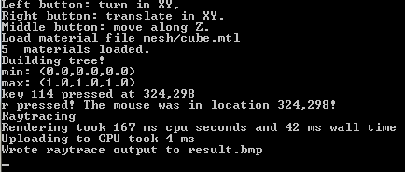
Octrees
Duration – result

Slide 23
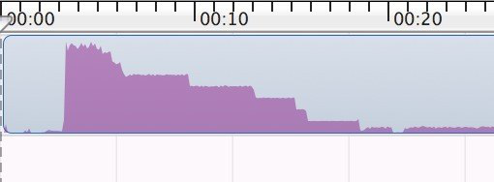
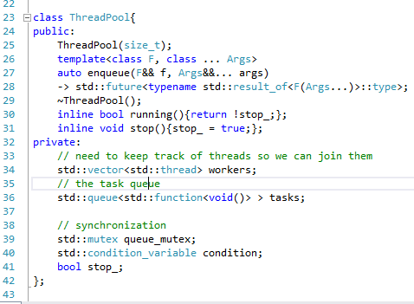
Multithreading
Duration – possible solution

Slide 24
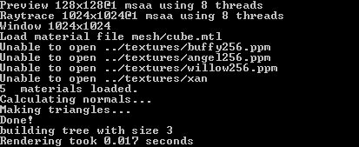
Multithreading
Duration – result, live rendering at 20+ fps

Slide 25
Presentation
The actual topics
Start of Project
Raytracing
Normals
Duration
Extras
Demo

Slide 26
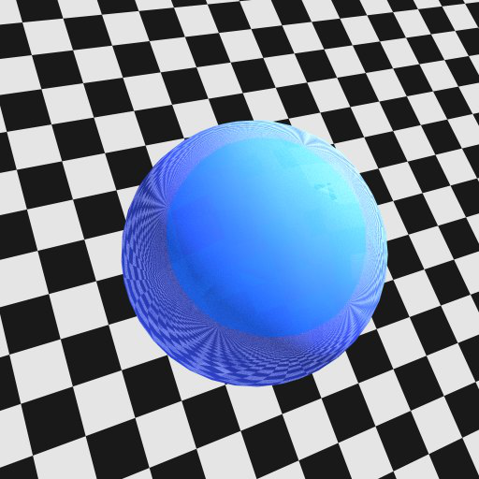
Reflection
Extras

Slide 27
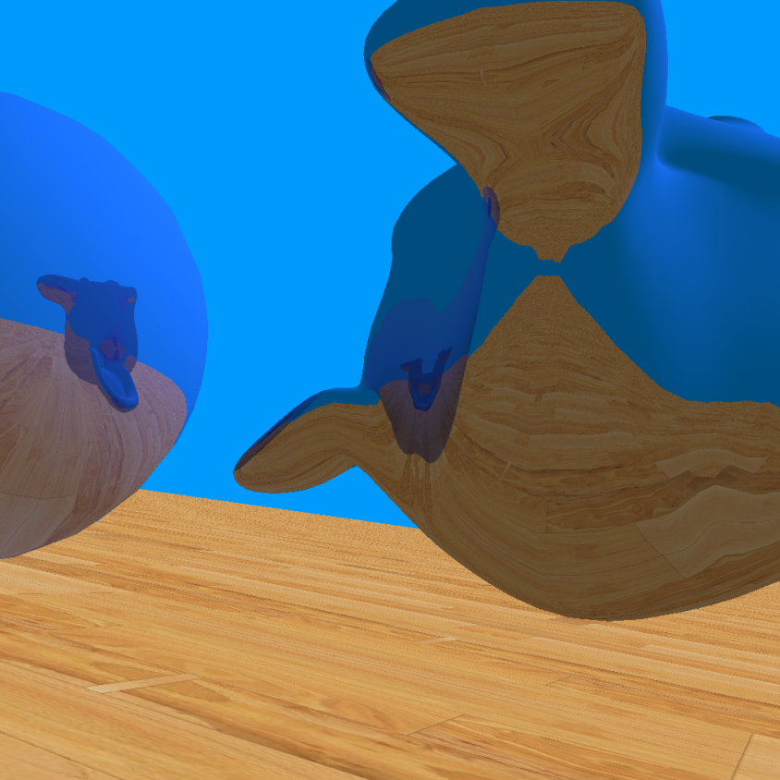
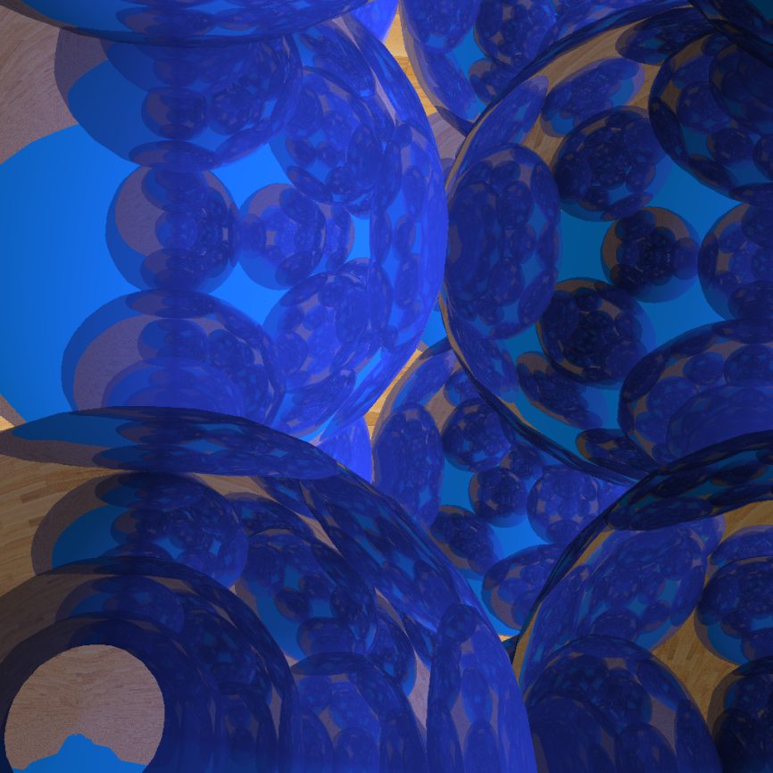
Reflection, onto other objects
Extras

Slide 28
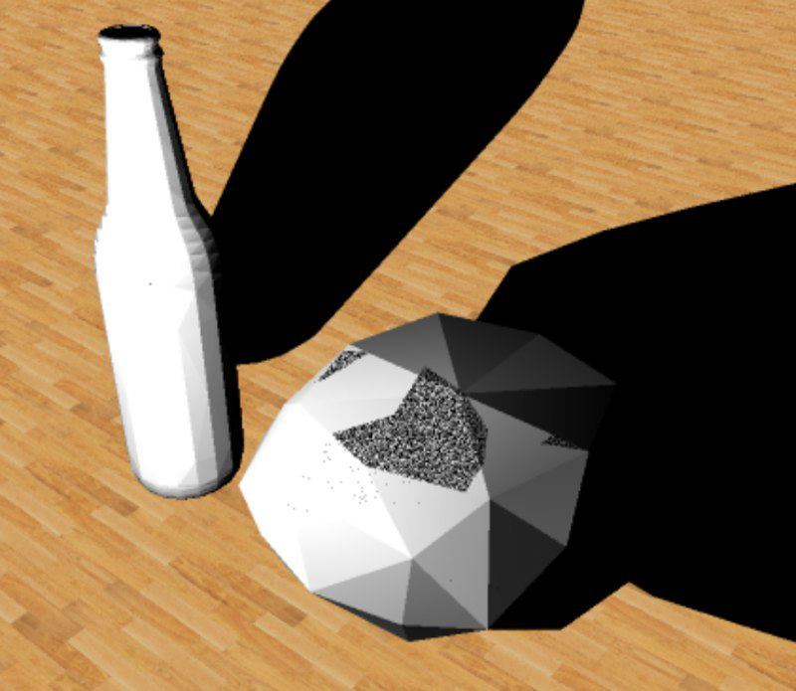
Shadows
Extras

Slide 29
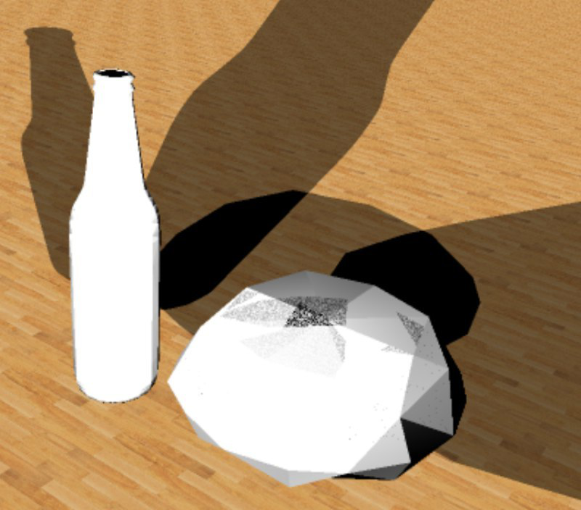
Shadows, multiple light sources
Extras

Slide 30
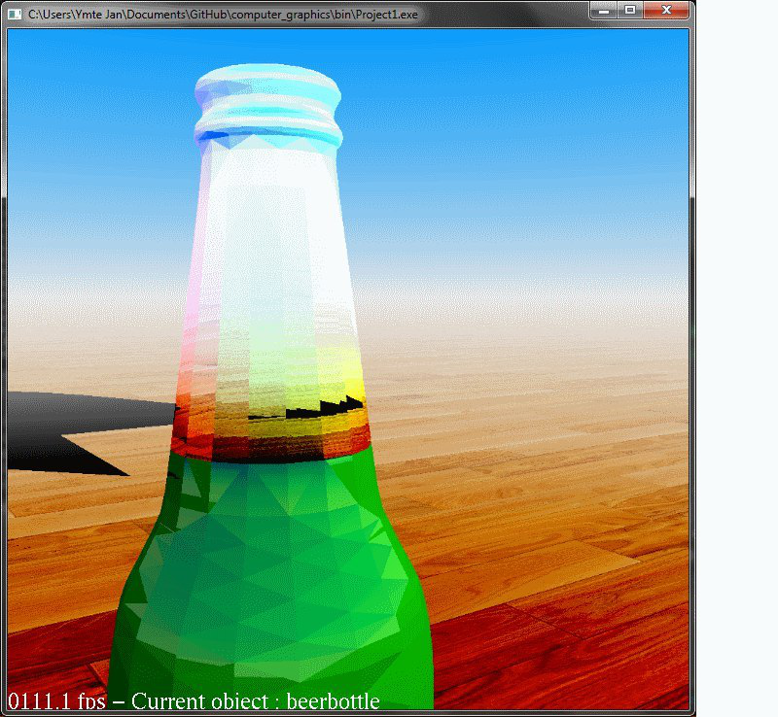
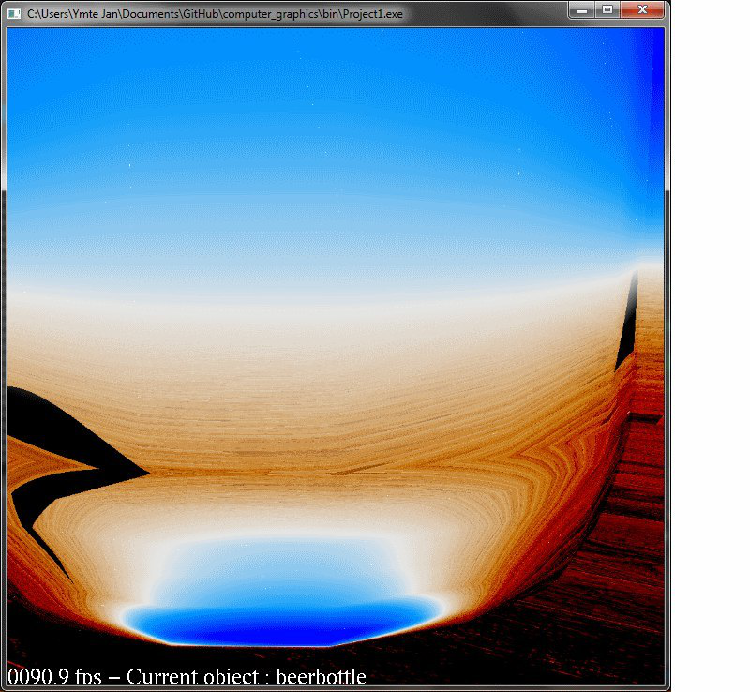
Refraction
Extras

Slide 31
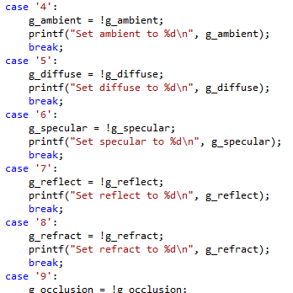
Toggle functions
Extras

Slide 32
Presentation
The actual topics
Start of Project
Raytracing
Normals
Duration
Extras
Demo

